Slide 1

Public Health Exploratory Analysis
Matt Ray, Jeremy Magee, Sam Lind, Lori Girton
Notes:
Lori

Slide 2
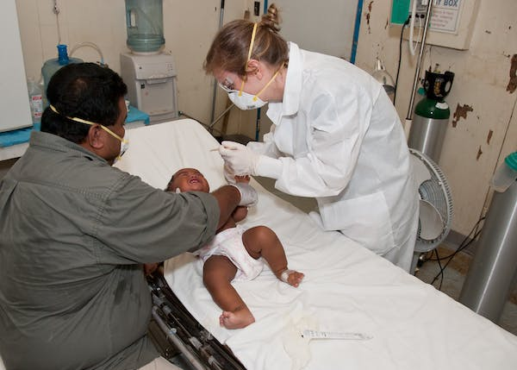
Our Project
Infant mortality stands as a critical indicator of a nation's overall health, attracting significant scrutiny and forming a cornerstone of public health research. The outcomes from these studies are pivotal, not merely for their academic value but more importantly, for their potential to guide evidence-based practice. These evidence-driven interventions, shaped by the nuanced understanding of factors influencing infant mortality, are indispensable for shaping health policies and programming that promise to secure the health and survival of our youngest citizens.
Infant mortality studies
Evidence-based practice creates reform
Shape health policy
Survival of infants
Notes:
Lori

Slide 3
The US National Center for Health Statistics found that North Carolina was one of sixteen states with infant mortality rates significantly higher than the U.S. mortality rate.
(Ely & Driscoll, 2022)
Notes:
Lori

Slide 4
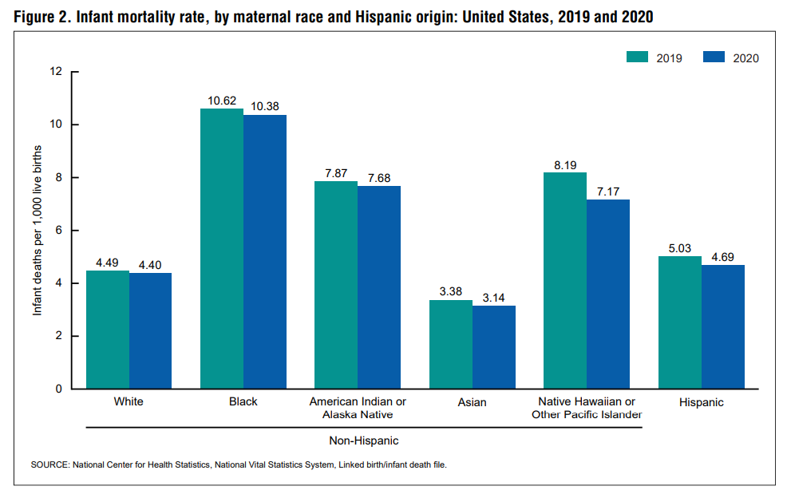
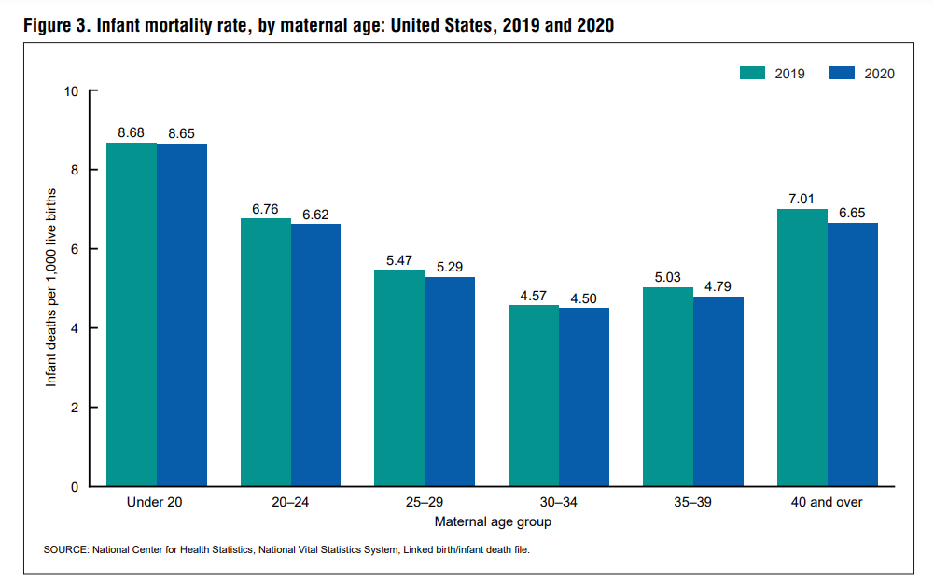
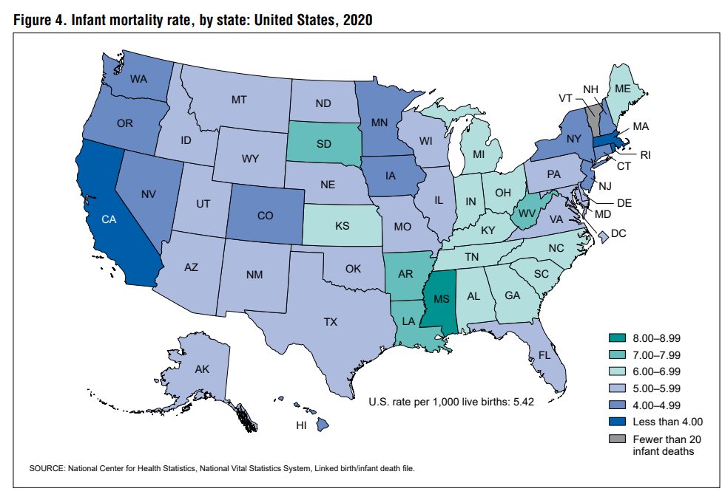
RACE
AGE
What could be the sub-factors leading race and age to present?
Demographics appear to highly impact the likelihood of Infant Mortality
(Ely & Driscoll, 2022)
https://www.cdc.gov/nchs/data/nvsr/nvsr71/nvsr71-05.pdf
Notes:
Matt

Slide 5
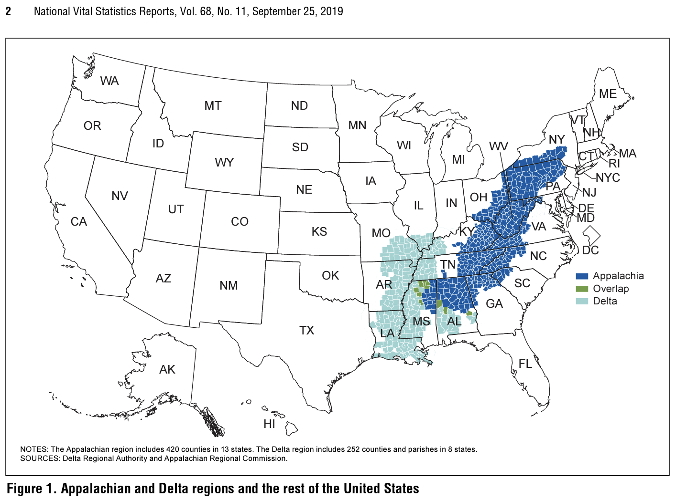
Results—Characteristics of women who gave birth differed across the three regions. Women in the Delta were most likely to be teenagers, unmarried, and not have a college degree, followed by women in Appalachia, and then by women in the rest of the United States. Overall and within most categories of maternal characteristics, infants born in the Delta were more likely to be preterm (12.37%) or low birthweight (10.75%) and were more likely to die in their first year of life (8.17 infant deaths per 1,000 live births) than those born in Appalachia (10.75%, 8.87%, and 6.82, respectively), while those born in the rest of the United States were the least likely (9.78%, 8.14%, and 5.67, respectively).
https://www.cdc.gov/nchs/data/nvsr/nvsr68/nvsr68_11-508.pdf
Notes:
Matt

Slide 6
Research Questions
Correlating Factors
Socio-Economic Factors
What factors correlate with infant mortality rates in North Carolina at the county level?
How do changing socio-economic factors contribute to the differing rates of infant mortality between counties?
Sub-Factors
What sub-factors of poverty are present consistently throughout socio-economic factors?
Notes:
Matt

Slide 7

01
Data Collection
Notes:
Sam

Slide 8
Data Sources
NC Office of State Budget and Management API
National Institute of Health
Education rates
Health facilities
Poverty
Public health
Education
Population demographics
Per capita income
All data are from the year 2020
Notes:
Sam

Slide 9
Cleaning Data
Ingest API data and CSVs
Save API outputs as useable .JSONs
Remove misspellings, extra spaces, fill 0’s
Convert all data sets into joinable fields
Merge into Master data frame
Categorize data by ability to normalize
Create .py files for import ability
Explore relationships
Notes:
Sam

Slide 10
Methodology
Accurate Data
Fill Zeros
Population Normalization
Assumptions
Not all counties came with infant death rates: We assumed that there were either no hospitals in the counties – or they were never reported.
We chose to populate the zeros because they were a small subset of the county list; statistical significance can still be gleaned by their regional correlations to poverty.
Categorize via a Dictionary
Summary Statistics
Measures
Per 1000
A subset within the Population
Compare Correlations
Not Per 1000
Comparisons
Ranking
Measures
Guide for Feature Selection
Things which we detect correlation against
Notes:
Jeremy

Slide 11
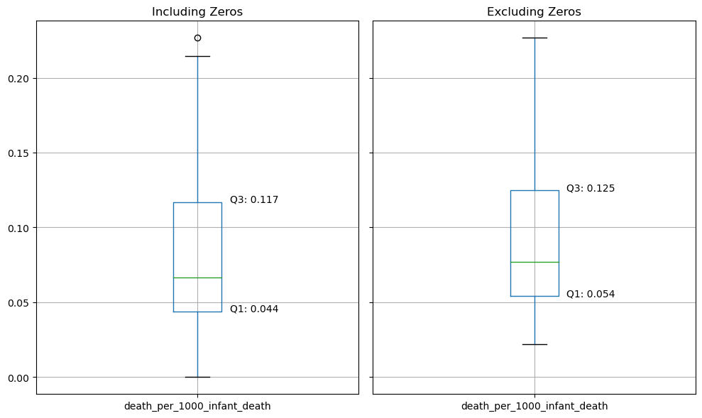
NC County Infant Deaths per 1K Residents
With Zeros:
Includes 1 outlier – which provides interesting insight
Is quite similar to the data without zeros
Without Zeros:
Gives a more accurate estimate of data distribution
Eliminates the outlier
Notes:
Jeremy

Slide 12
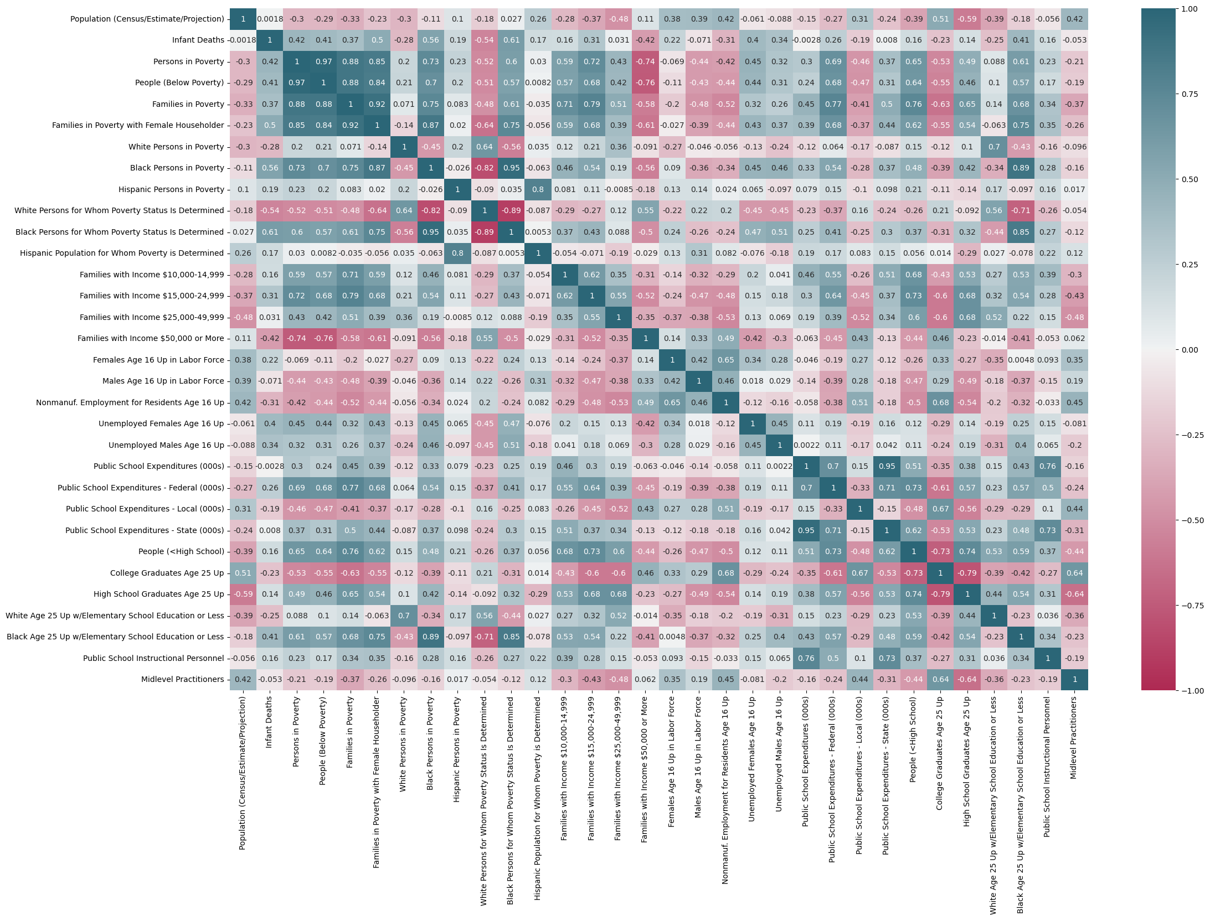
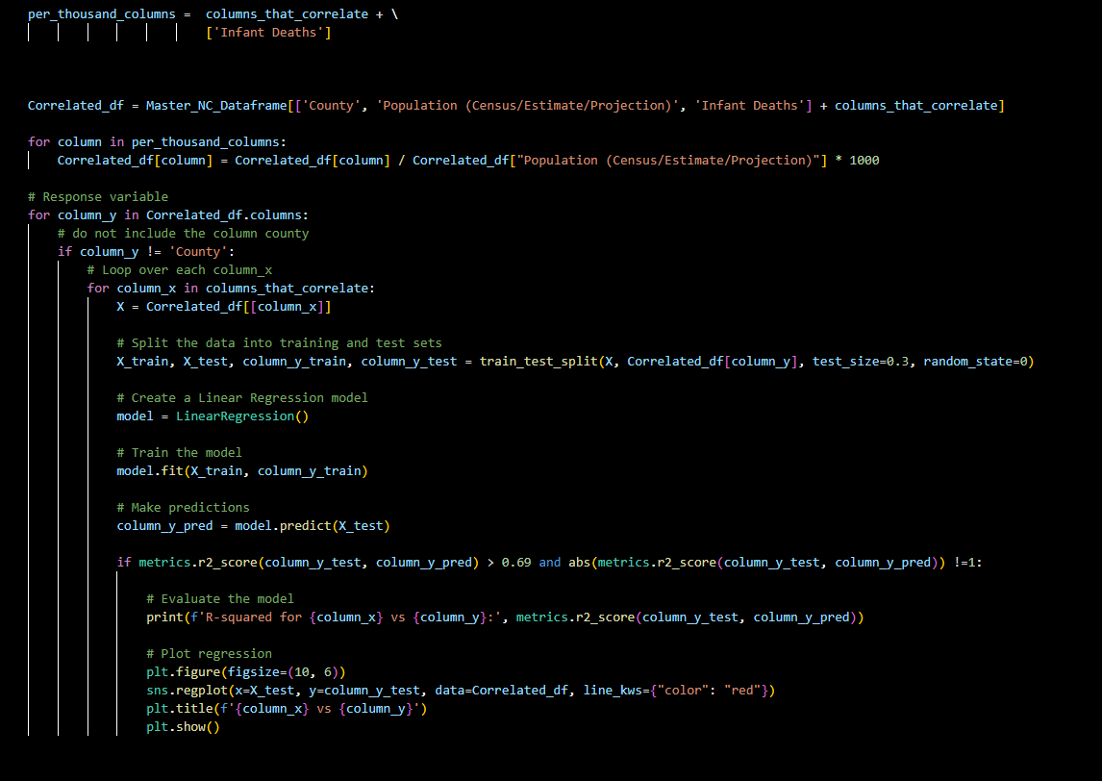
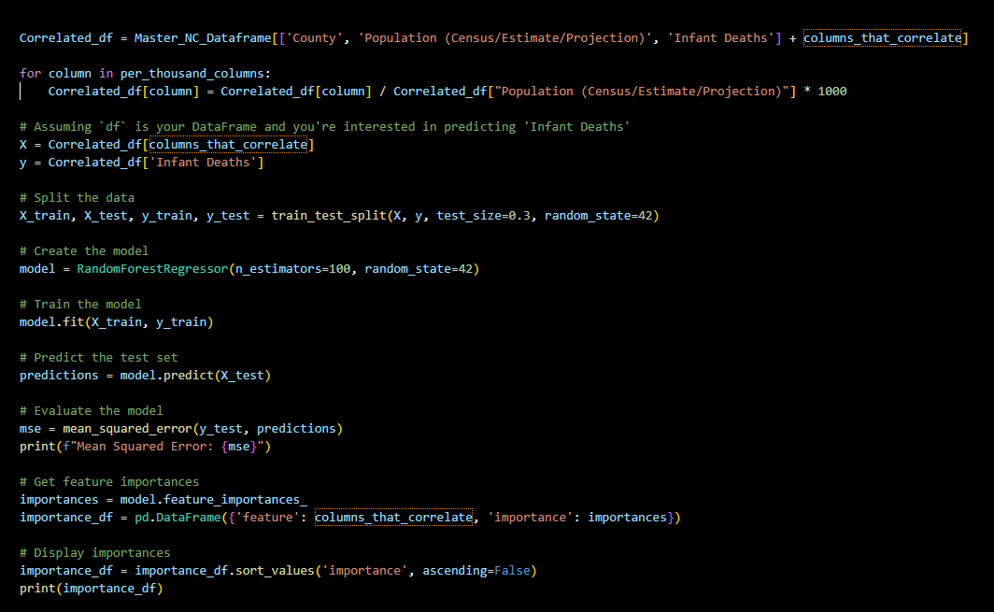
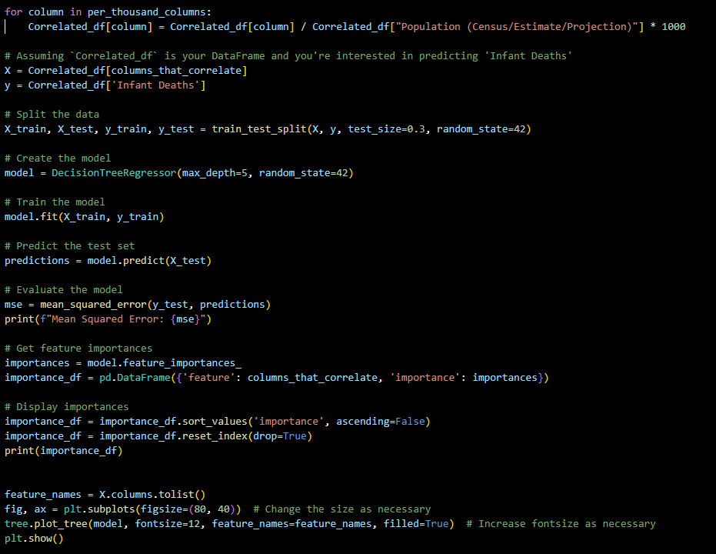
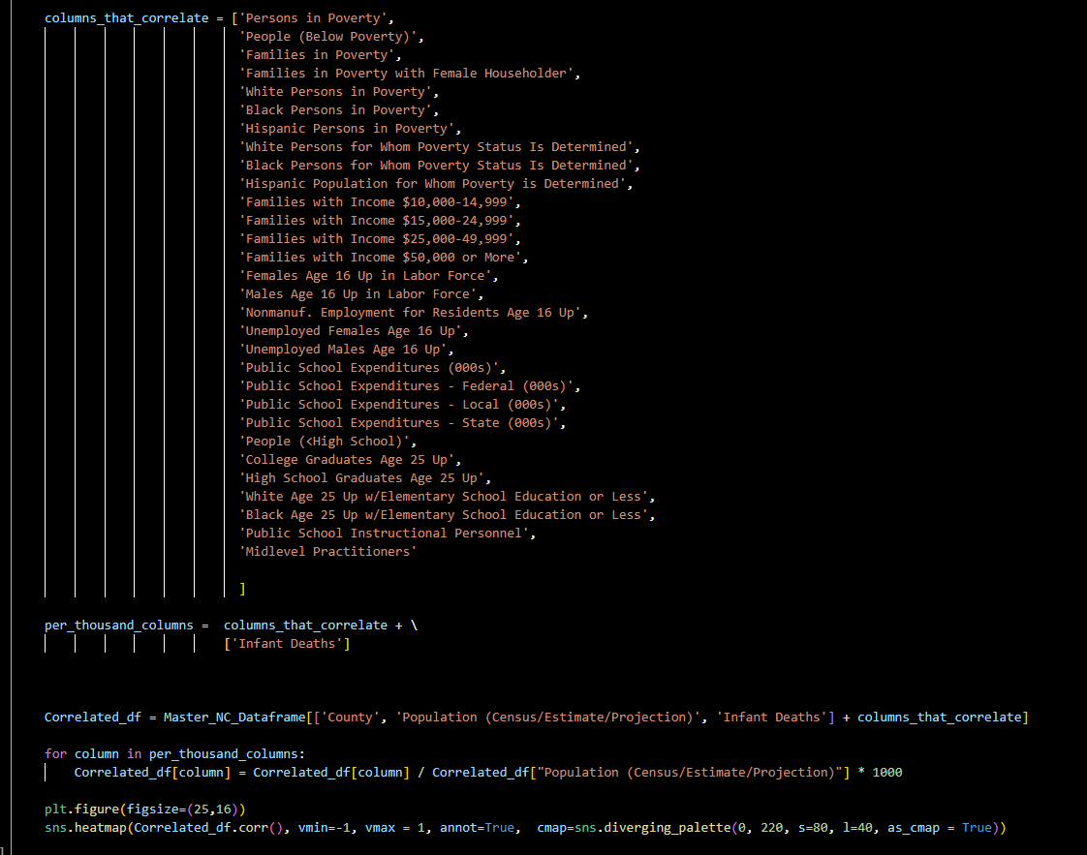
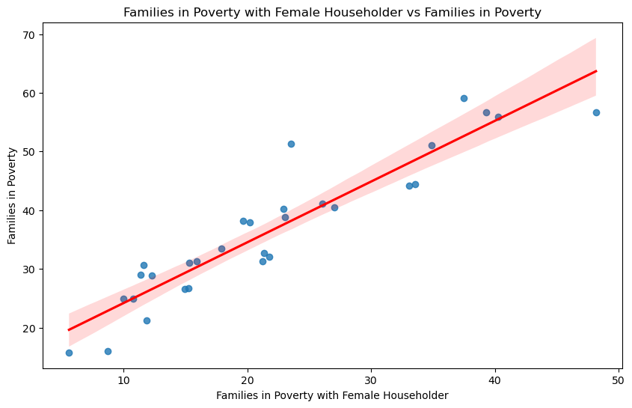
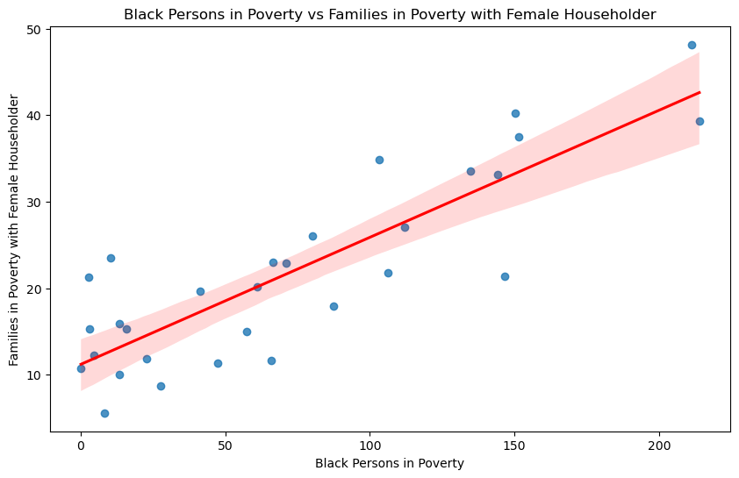
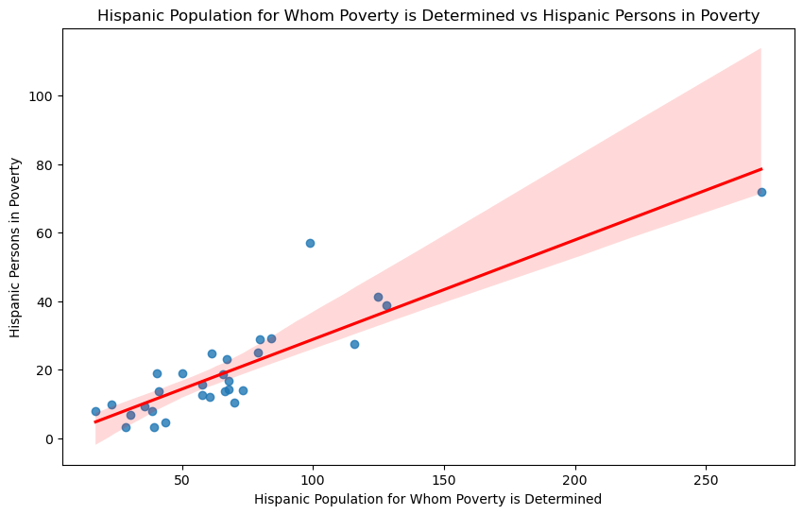
Code & Demonstration of Application
Generate Correlation Heatmap via Seaborn
R Squared, Regression, and Confidence
Random Tree Regression
Decision Tree Regression
Mean Squared Error: 0.002333636506413632
FEATURE IMPORTANCE
Black Persons for Whom Poverty Status Is Deter... 0.273631
White Persons for Whom Poverty Status Is Deter... 0.151372
Hispanic Population for Whom Poverty is Determ... 0.044861
Black Persons in Poverty 0.042048
Hispanic Persons in Poverty 0.037681
Public School Expenditures - Federal (000s) 0.036343
Midlevel Practitioners 0.030895
Unemployed Males Age 16 Up 0.030437
Families with Income $25,000-49,999 0.026870
Families with Income $50,000 or More 0.026241
Public School Expenditures - State (000s) 0.024861
Public School Expenditures (000s) 0.022183
College Graduates Age 25 Up 0.021580
Black Age 25 Up w/Elementary School Education ... 0.021185
Unemployed Females Age 16 Up 0.020576
Families in Poverty with Female Householder 0.020194
People (<High School) 0.019896
Families in Poverty 0.018593
Public School Instructional Personnel 0.016298
Females Age 16 Up in Labor Force 0.014484
People (Below Poverty) 0.013831
Families with Income $15,000-24,999 0.011216
Nonmanuf. Employment for Residents Age 16 Up 0.010996
High School Graduates Age 25 Up 0.010765
White Persons in Poverty 0.010543
White Age 25 Up w/Elementary School Education ... 0.010352
Families with Income $10,000-14,999 0.010175
Persons in Poverty 0.007709
Public School Expenditures - Local (000s) 0.007656
Males Age 16 Up in Labor Force 0.006529
Mean Squared Error: 0.0029970086218754147
Regression models provide confidence in feature selection
Use the heatmap to determine the most impactful socio-economic factors
Deep Dive the correlations to confirm possible fit
Notes:
Matt

Slide 13
02
Data Analysis
Notes:
Matt

Slide 14

Correlating Factors
What factors correlate with infant mortality rates in North Carolina at the county level?
Notes:
Matt

Slide 15
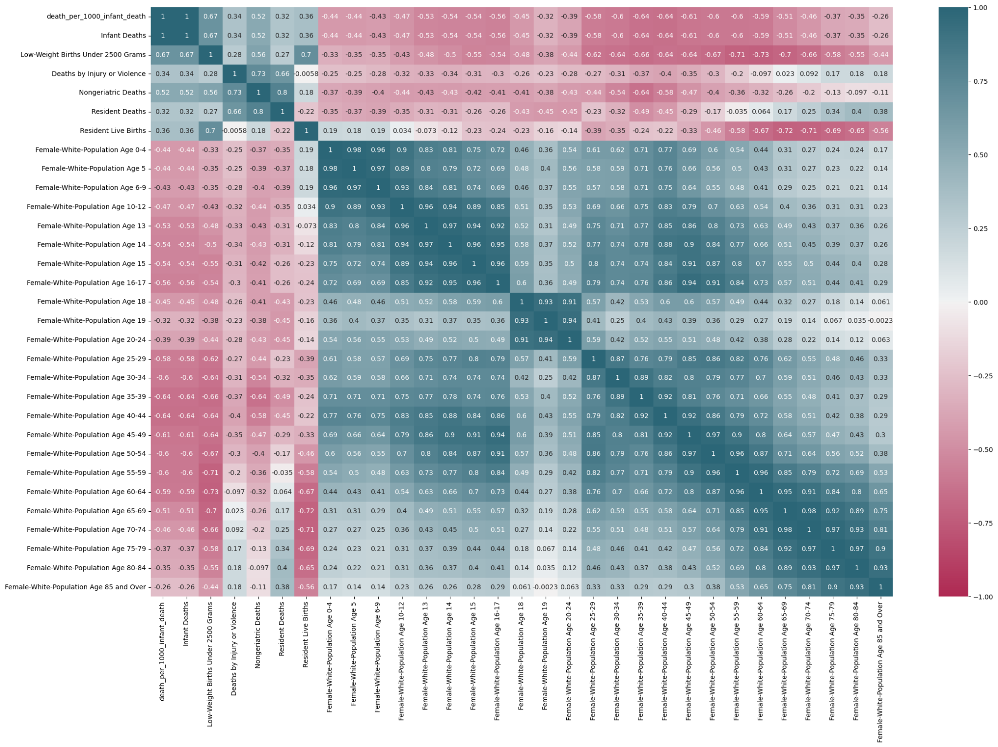
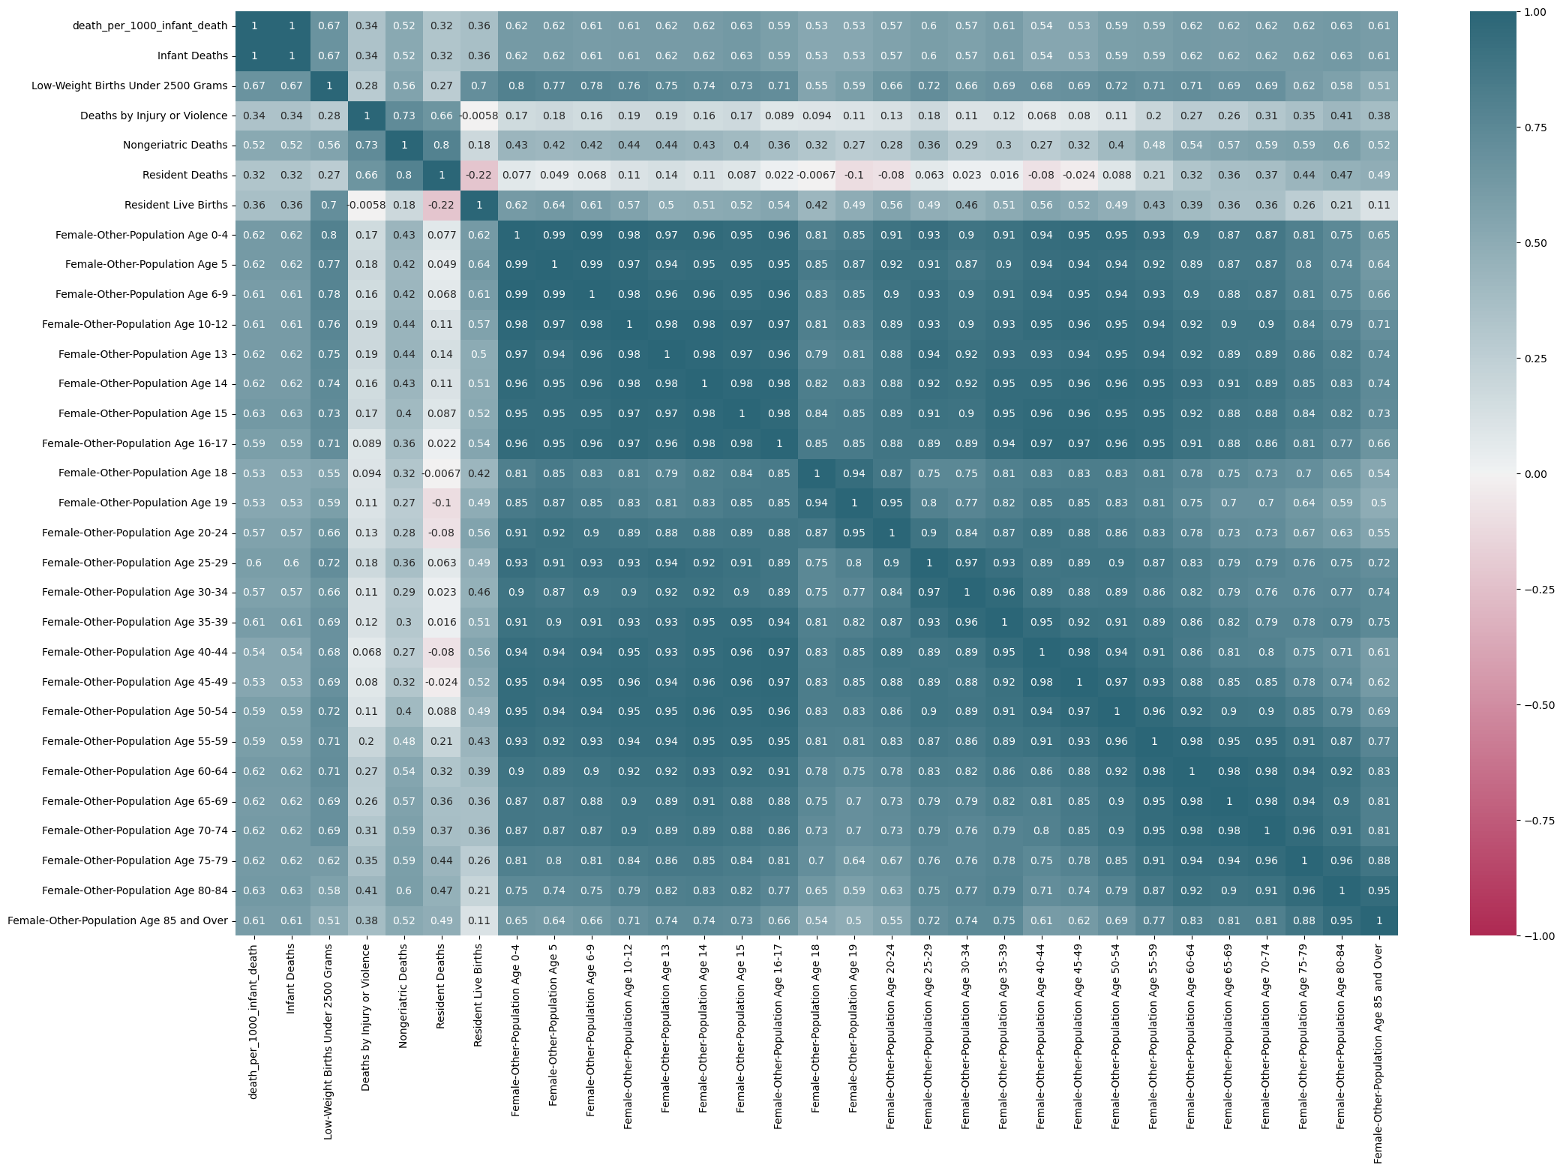
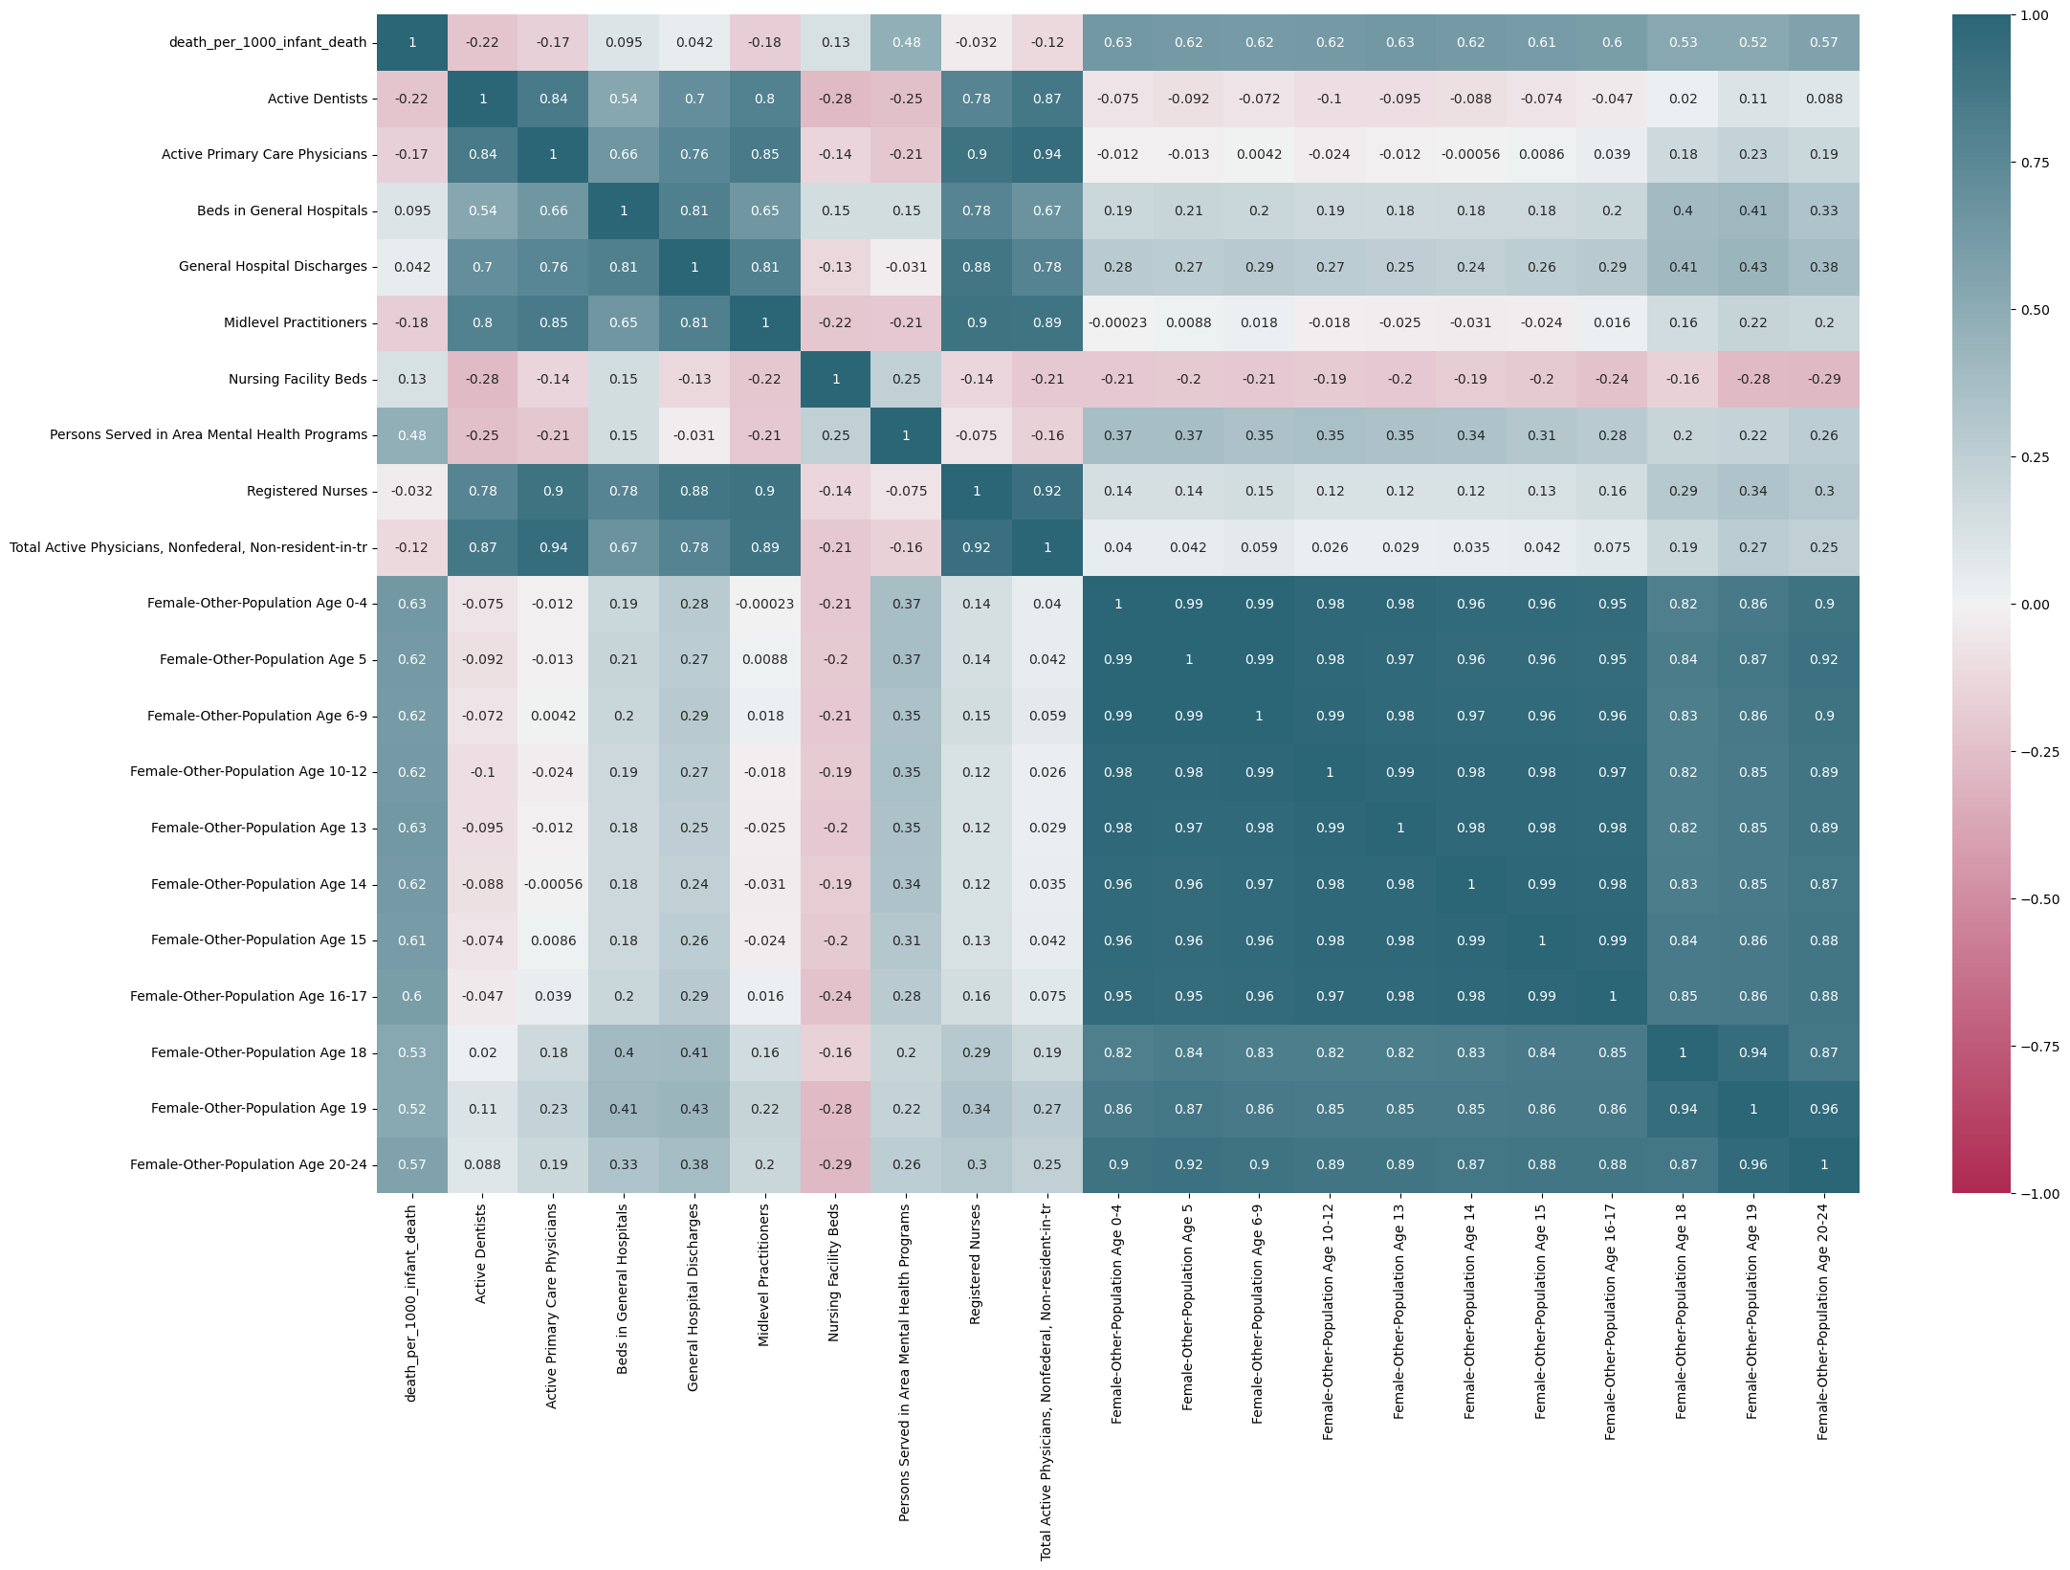
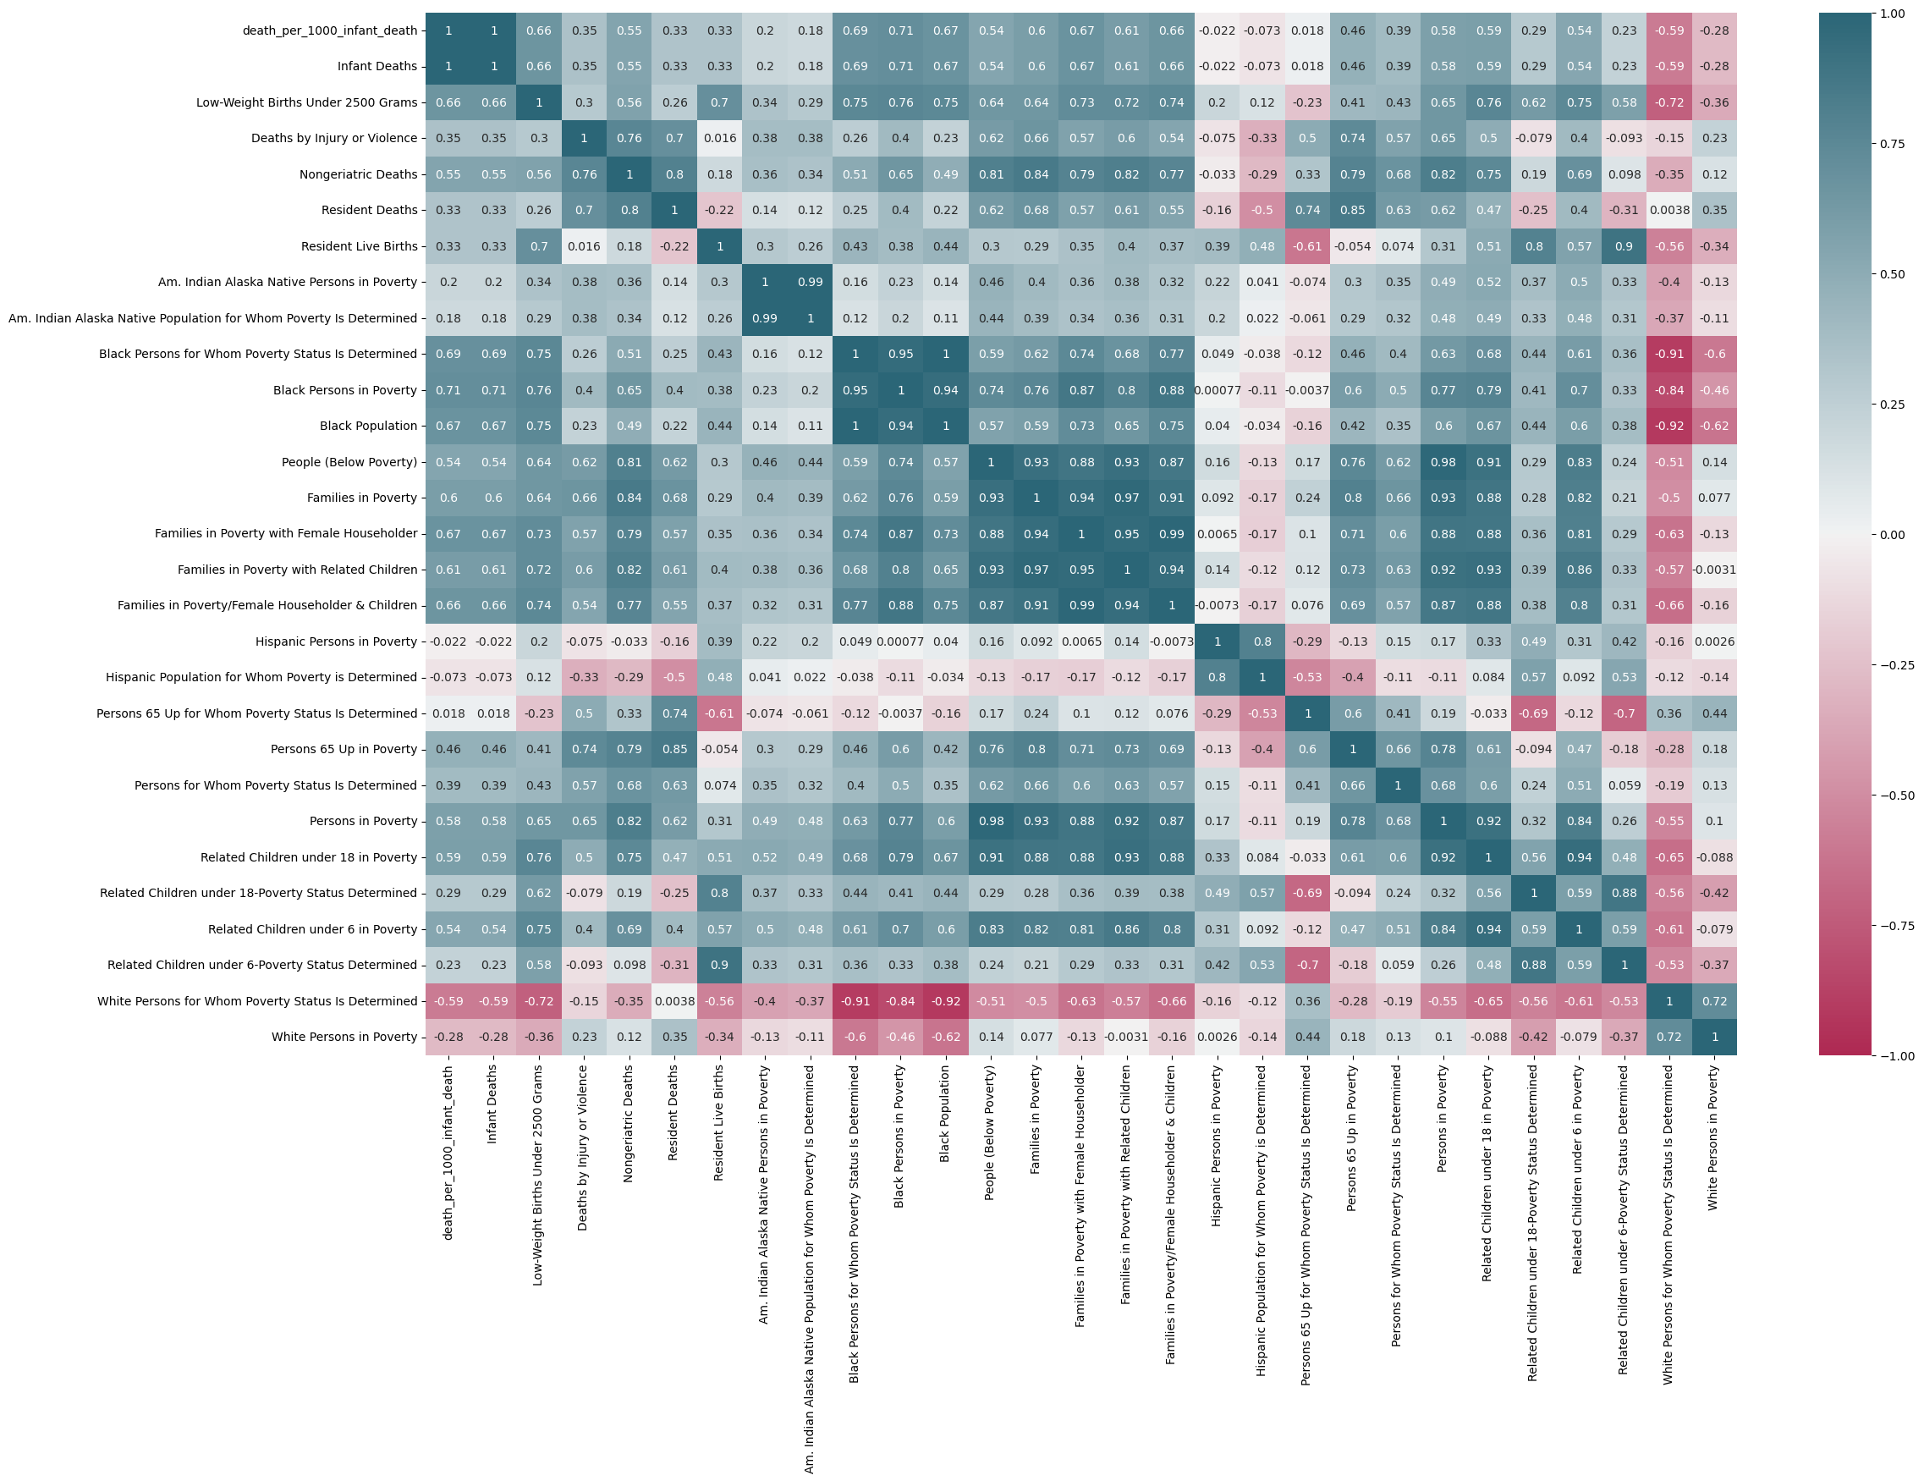
There Can Be Only ONE!*
Correlation Heat maps provide every possible combination of factors and their correlation values
FINAL SELECTION
Persons in Poverty
People (Below Poverty)
Families in Poverty
Families in Poverty with Female Householder
White Persons in Poverty
Black Persons in Poverty
Hispanic Persons in Poverty
White Persons for Whom Poverty Status Is Determined
Black Persons for Whom Poverty Status Is Determined
Hispanic Population for Whom Poverty is Determined
Families with Income $10,000-14,999
Families with Income $15,000-24,999
Families with Income $25,000-49,999
Families with Income $50,000 or More
Females Age 16 Up in Labor Force
Males Age 16 Up in Labor Force
Nonmanufacturing Employment for Residents Age 16 Up
Unemployed Females Age 16 Up
Unemployed Males Age 16 Up
Public School Expenditures (000s)
Public School Expenditures - Federal (000s)
Public School Expenditures - Local (000s)
Public School Expenditures - State (000s)
People with Less Than High School Education
College Graduates Age 25 Up
High School Graduates Age 25 Up
White Individuals Age 25 Up with Elementary School Education or Less
Black Individuals Age 25 Up with Elementary School Education or Less
Public School Instructional Personnel
Midlevel Practitioners
Through rigorous testing – we were able to sort the all the individual categories we established and determine the most important factors
*Highlander
Notes:
Matt

Slide 16

Non-White Females and Health Outcomes
Non-white female population (per thousand residents) is positively correlated with infant death rates and low birthweight.
R-values range from 0.53 to 0.63.
IMPORTANT: Race is not a factor in health, but socio-economic influences are.
So, what else explains these discrepancies?
Notes:
Sam

Slide 17
Socio-Economic Factors
How do changing socio-economic factors contribute to the differing rates of infant mortality between counties?
Notes:
Sam

Slide 18

Poverty vs. Health Outcomes
Proportion of people in poverty positively correlates with infant mortality (r = 0.54).
Families in poverty does as well (r = 0.6).
Black population also positively correlated with poverty statistics (R-values of 0.57 and 0.59).
Poverty better explains variations in infant mortality than race. Our feature selection confirms poverty’s role in Infant Death
Notes:
Sam

Slide 19
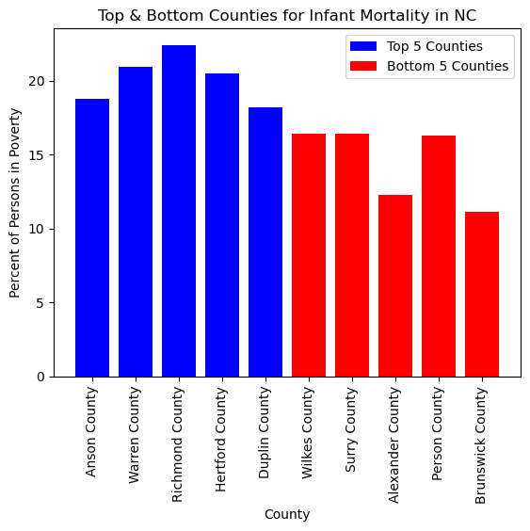
Top 5 Counties vs. Bottom 5 Counties
Top and bottom 5 counties for infant mortality
Comparing poverty rates for each county.
The largest percentages of persons in poverty are interestingly not in the most (or least) populous counties.
Notes:
Lori

Slide 20
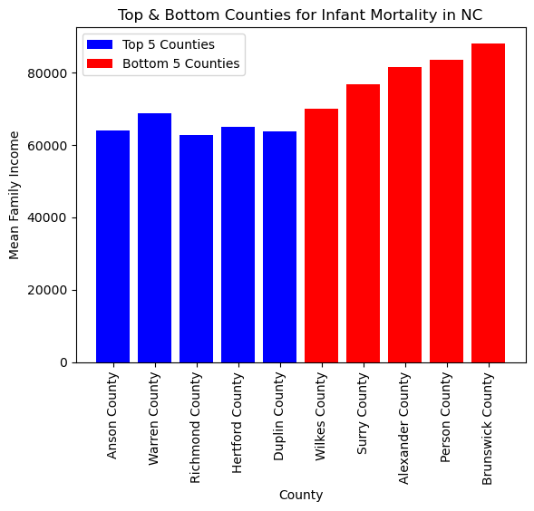
Top 5 Counties vs. Bottom 5 Counties
Top and bottom 5 counties for infant mortality comparing mean family incomes.
This comparison shows that there is a negative relationship between mean family income and infant mortality rates.
Notes:
Lori

Slide 21
Sub-Factors
What sub-factors of poverty are present consistently throughout socio-economic factors?
Notes:
Jeremy

Slide 22
Statistical Analysis
Female head of house (e.g. Single-Parent) was the most consistent sub-factor in our measured socioeconomic data.
Black female-headed families were more likely to be in poverty.
Likelihood of a person in poverty being black (p = 0.341) was twice as likely as being white (p = 0.17), despite the populations being in a ratio of White to Black women of 1.91:1.
Highest finished level of education and level of income were other sub-factors.
Increase in highest level of education reduces poverty.
Notes:
Jeremy

Slide 23
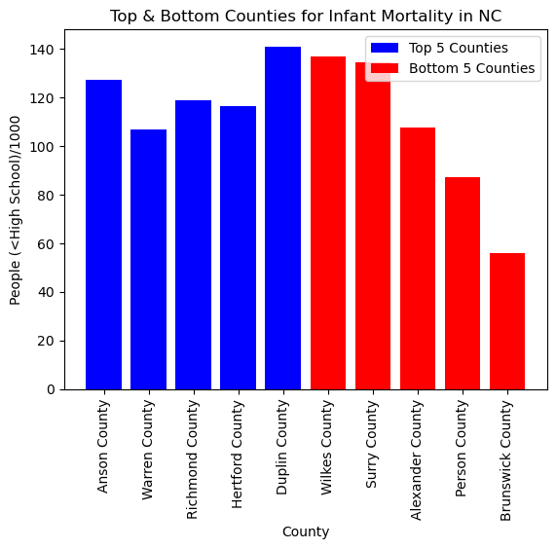
Top 5 Counties vs. Bottom 5 Counties
The bottom 5 counties for infant mortality average a higher number of citizens with less than a high school education.
3 out of the bottom 5 counties for infant mortality had less citizens with less than high school education.
Notes:
Jeremy

Slide 24
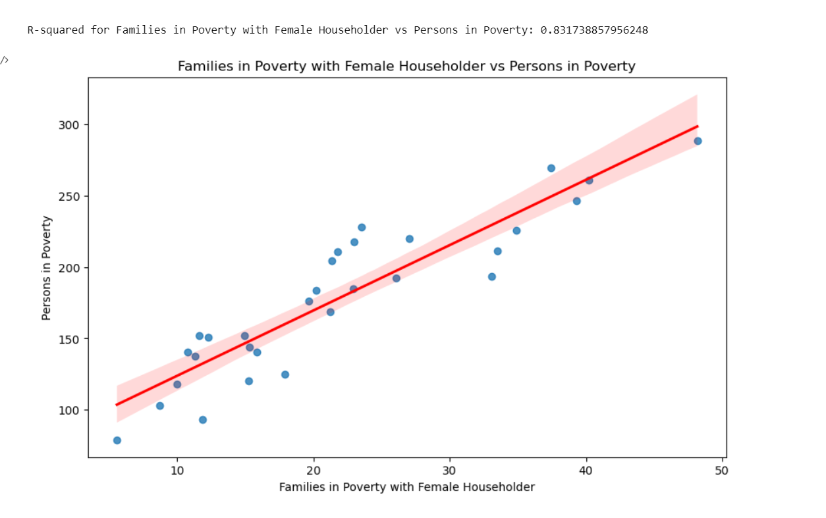
Families in Poverty with Female Householders showed correlation with ALL types of poverty
This suggests that single families – particularly single mothers, are highly correlated with infant mortality rate.
This constitutes an argument for poverty over race as a higher contributing factor in overall infant mortality
Notes:
Jeremy

Slide 25
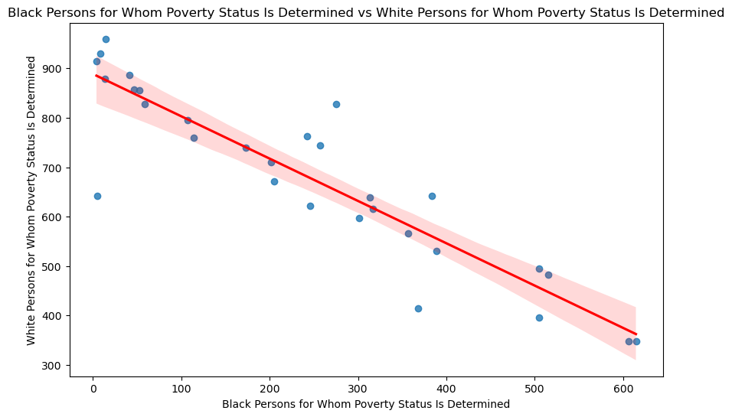
Black Poverty vs. White Poverty
We found an interesting correlation between determined white poverty vs determined black poverty.
The relationship suggests an inverse relationship - possibly suggesting geographic dispersion** at the county level of race when races are in poverty.
**Because there was no similar correlation in higher income areas it suggests that this only applies in a poverty setting and that
high income areas are racially diverse
Notes:
Jeremy

Slide 26
03
Conclusions
Notes:
Jeremy

Slide 27
Summary and Conclusions
North Carolina counties display variation in rates of infant mortality along lines of race.
Poverty serves as a much better indicator of infant mortality between different counties.
Poverty affects black North Carolinians at much higher rates than it does white North Carolinians.
Notes:
Jeremy

Slide 28
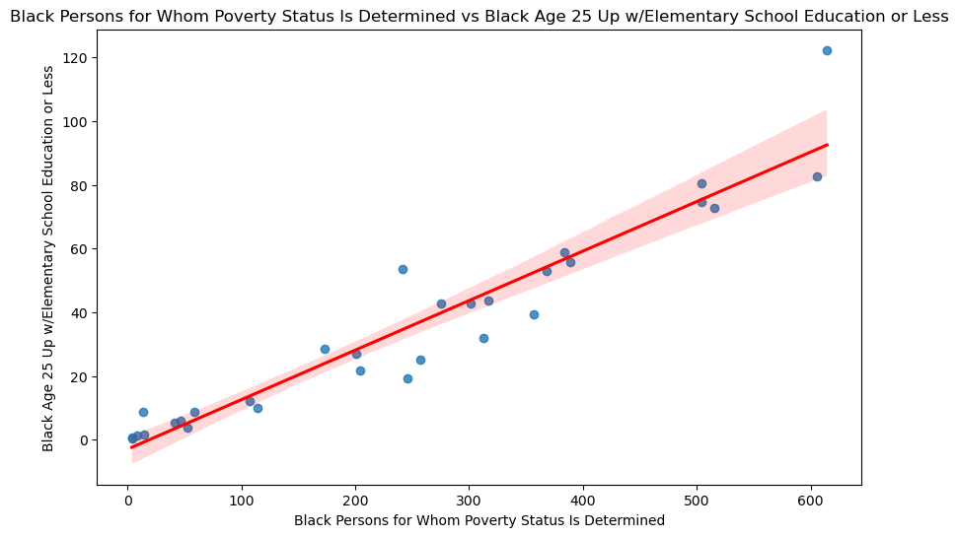
Unanticipated Insights or Problems
The infant deaths did not have any racial component to the data. We could not fix this, so we had to make some assumptions.
An unanticipated insight was the positive correlation between amount of poverty and educational spending. The more poverty there was, the higher the educational spending.
The black population age 25 and up with only Elementary education and that it correlated with the amount of poverty in the county was a surprising statistic.
Notes:
Jeremy

Slide 29

Thanks
Please keep this slide for attribution

Slide 30
Resources
Ely, Danielle M. & Driscoll, Anne K. (2022). Infant Mortality in the United States, 2020: Data From the Period Linked Birth/Infant Death File. National Vital Statistics Reports, Volume 71, Number 5. Retrieved from https://www.cdc.gov/nchs/data/nvsr/nvsr71/nvsr71-05.pdf.
Ely, Danielle M. & Driscoll, Anne K. (2019). Maternal Characteristics and Infant Outcomes in Appalachia and the Delta. National Vital Statistics Reports, Volume 68, Number 11. Retrieved from https://www.cdc.gov/nchs/data/nvsr/nvsr68/nvsr68_11-508.pdf.
Photo Credits
Linked in photos.

